Slide 1
Internal Assessment 1

Slide 2
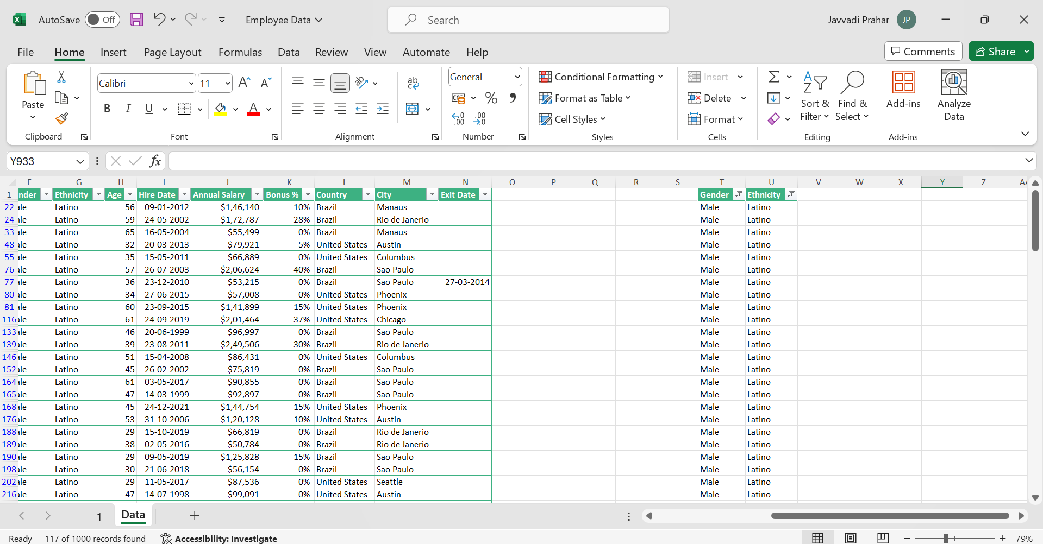
1.
Asian ➔ Male ( 197 employees)
Female ( 207 employees)
Black ➔ Male (37 employees)
Female (37 employees)
Caucasian ➔ Male ( 131 employees)
Female( 140 employees)
Latino ➔ Male ( 118 employees)
Female ( 134 employees)

Slide 3
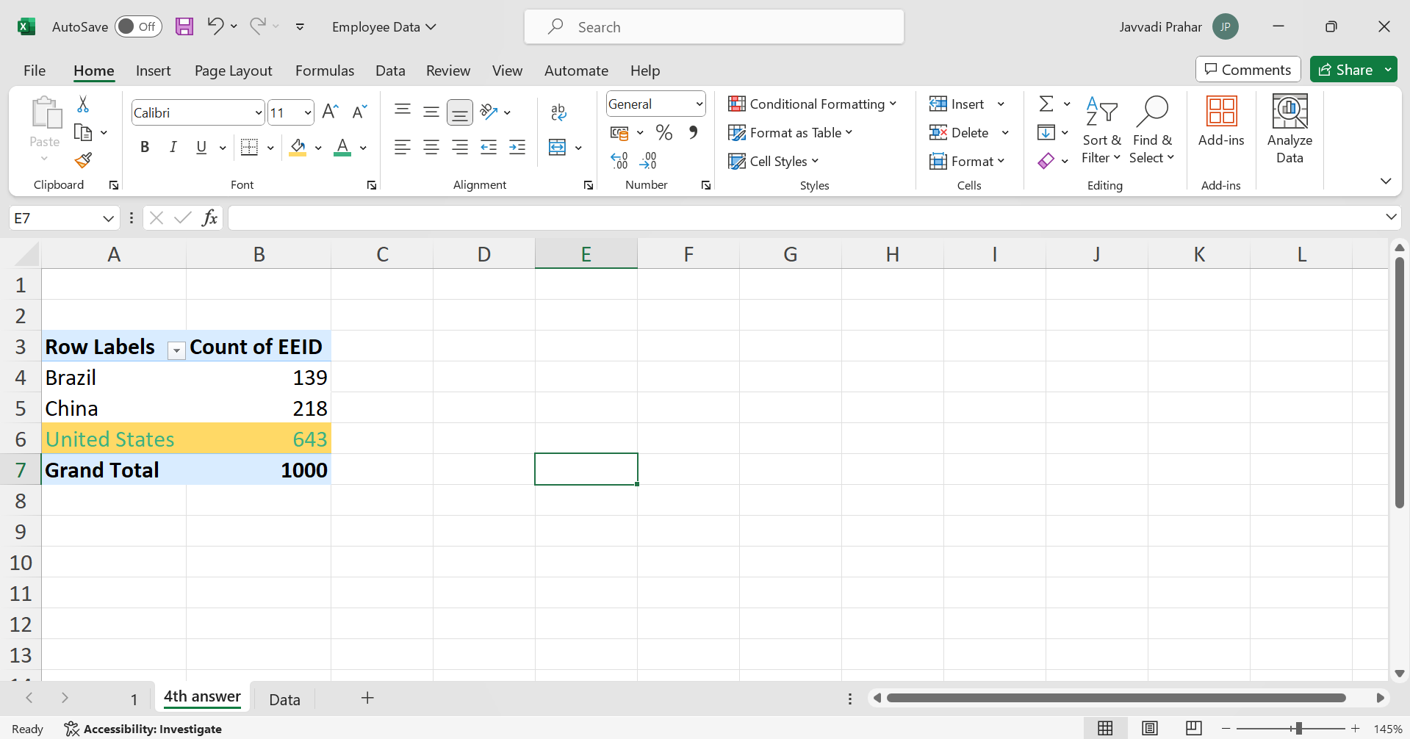
4.
“United States has the highest number of employees”

Slide 4
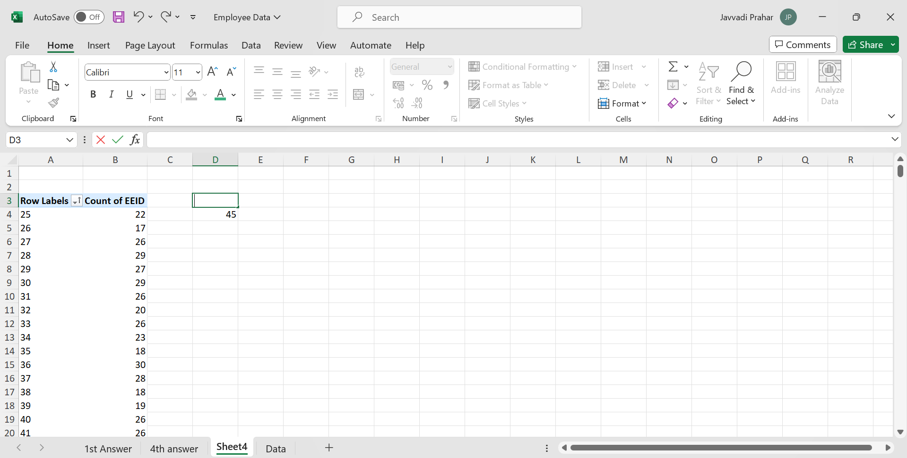
5.
“Most Common age among the employees”

Slide 5
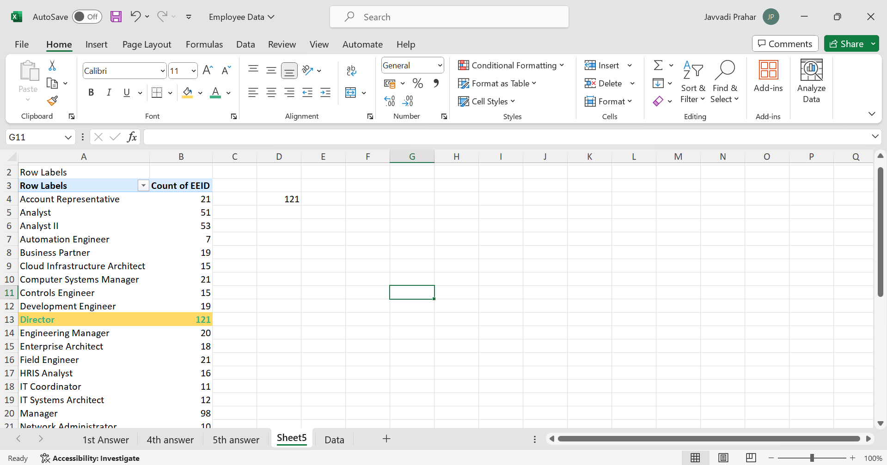
7.
“Director job title is the most frequent in the data set ”

Slide 6
7.
“Director job title is the most frequent in the data set ”

